Slide 1
Team Vladimir Nabokov
CHAOS GAME
Members:
Martin Antonov
Milko Venkov
Luchezar Nikolov
Roman Peshterski
Liubomir Dimitrov

Slide 2
Game information
Gameplay
Controls
Known issues
Further development

Slide 3
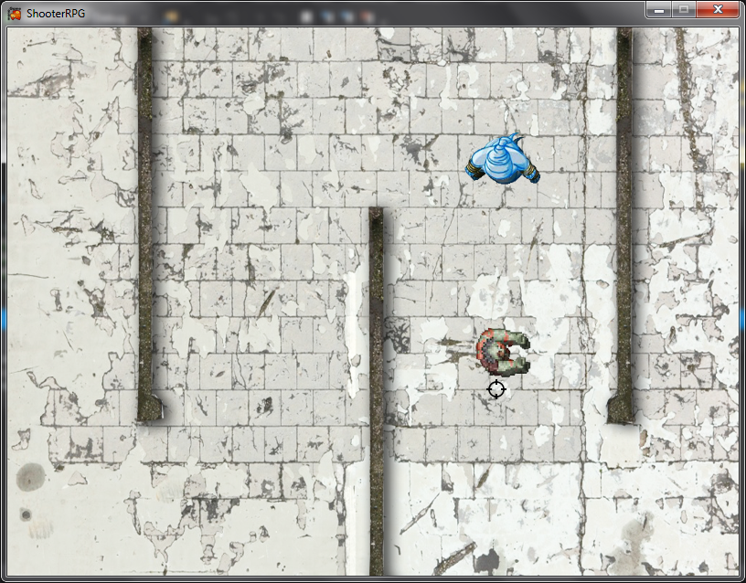
Demo

Slide 4
Additional information
Known issues
Further development

Slide 5
Github repository
https://github.com/lsnickolov/ChaosRPG/tree/master/ShooterRPG

Slide 6
LETS PLAY!

